Slide 1
Escenic Playback II
Notes:
The below and following notes on the template slides are to guide you only. In your final presentation, you may delete these notes and add relevant notes if any.
Title slide:
Title – should not exceed beyond 3 lines, font size 30-34, Arial Headings
(Font size for the title of the PPT can vary between 30-34, Arial Headings, Bold depending on the amount of text, however should not be smaller than 30 font size)
Name should not exceed beyond 1 line, Designation; font size to remain at 18, Arial Headings
Please keep the title slide simple, just the logo, title and name and designation to appear. No other graphic elements or any design, photograph, image can be added to this slide, alignment to remain the same

Slide 2
Agenda
KIT Software Suite
Syndication Outbound
Bridge Integration
KIT Software Suite
Ads & Jobs
News Letters Press+ and Synchronex

Slide 3
The Kit (Software Suite)
Notes:
The below and following notes on the template slides are to guide you only. In your final presentation, you may delete these notes and add relevant notes if any.
Title slide:
Title – should not exceed beyond 3 lines, font size 30-34, Arial Headings
(Font size for the title of the PPT can vary between 30-34, Arial Headings, Bold depending on the amount of text, however should not be smaller than 30 font size)
Name should not exceed beyond 1 line, Designation; font size to remain at 18, Arial Headings
Please keep the title slide simple, just the logo, title and name and designation to appear. No other graphic elements or any design, photograph, image can be added to this slide, alignment to remain the same

Slide 4
The Kit (Software Suite)
The kit is the collection of software for syndication
Syndication is the migration of the configuration of Escenic sections from one environment to environment .
Once syndication has occurred, section parameters are pushed to the destination environment
This kit is made up of the following
Cannon
Expose
Lightmeter
Fixer
Shutter
Filters

Slide 5
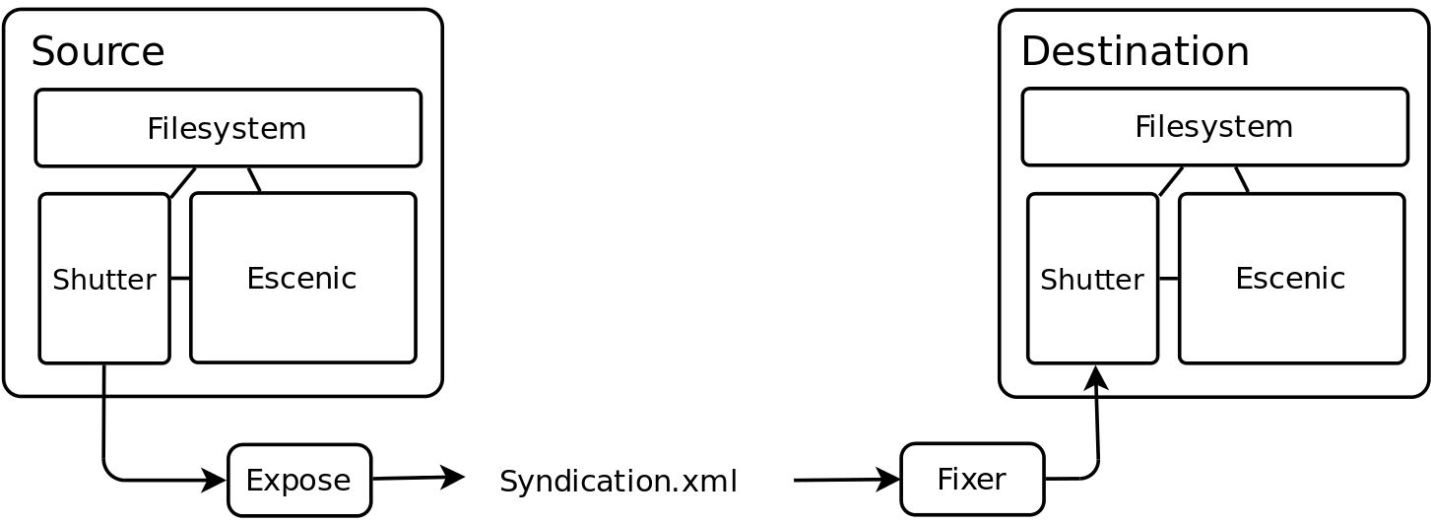
The Kit (Software Suite)

Slide 6
CANNON
Cannon is a program to handle the most common tasks
Cannon has multiple flows, each flow represents a step in the development process
Flow | From | To
ms-prod | Mothership on dev | All publications on production
ms-qa1 | Mothership on dev | All publications on QA1
ms-qa2 | Mothership on dev | All publication on QA2
ms-train | Mothership on dev | Production training publication
pg-ms | Playground on dev | Mothership on dev
Syndication happens from QA to PROD environment through Mothership
Cannon is stored in the fixer repository.

Slide 7
SHUTTER
Is a http based service to facilitate importing and exporting xml for Escenic syndication
Escenic requires filesystem access to read and write export/import
Shutter provides in interface to do this.
Has been implemented in GO

Slide 8
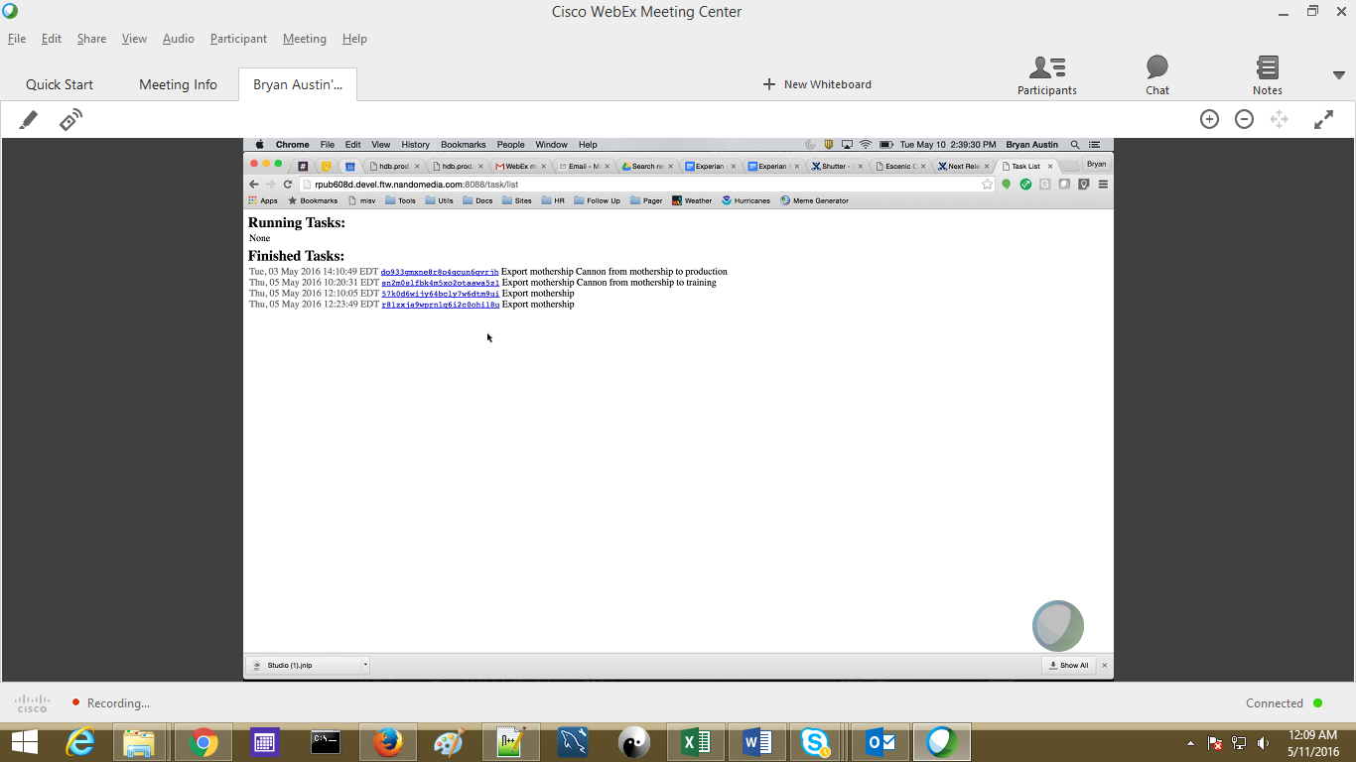
EXPOSE & LIGHTMETER
Expose is a program intended to run from a bash environment that will interface with Shutter to export and download syndication xml
The default behavior will start an export, print the progress as it happens and download the files when they're finished.
Has been implemented in GO
Lightmeter is a wrapper program to add common convenience functions to the Expose program functionality
Lightmeter implements recursive functionality, that expose does not have.
Lightmeter will check that sections specified exist.
Lightmeter will automatically go out and get all widgets from the given publication and include them in the request
Has been implemented in PYTHON

Slide 9
FIXER
Fixer is a program intended to run from a bash environment that will interface with Shutter to upload and import syndication xml
Fixer will accept multiple files also. The publications will run in parallel. Escenic does it's own locking to process them one at a time.
Has been implemented in GO

Slide 10
FILTER
Filters is a wrapper for any processing that needs to be done to Escenic syndication xml
Has been implemented in GO & PYTHON

Slide 11
Ads
Notes:
The below and following notes on the template slides are to guide you only. In your final presentation, you may delete these notes and add relevant notes if any.
Title slide:
Title – should not exceed beyond 3 lines, font size 30-34, Arial Headings
(Font size for the title of the PPT can vary between 30-34, Arial Headings, Bold depending on the amount of text, however should not be smaller than 30 font size)
Name should not exceed beyond 1 line, Designation; font size to remain at 18, Arial Headings
Please keep the title slide simple, just the logo, title and name and designation to appear. No other graphic elements or any design, photograph, image can be added to this slide, alignment to remain the same

Slide 12
Ads - Overview
McClatchy uses Dart for Publishers (DFP), also known as Google Publisher Tags (GPT).
The site is responsive, and so are the ads also. Google Ad server decides which breakpoint is being viewed and delivers the correct ad.
Most targeting values are requested by Ad operations as a way to specify what gets delivered.
Ads are generated based on key value pairs. Only size and ad unit are intrinsic to DFP ads. Keys must be added in our DFP account before being added to code.
Location of tag in the code has liner relation with the position of Ad in app
Click on empty space in a page and type adinfo to get all the details of the ads in the page. Adinfo is used as their debugging
Different sizes for ads are available for different screen sizes based on the resolution.
Everything is same template for website be it desktop/tablet/mobile. apps it’s entirely different.
MCC created two ads with JavaScript within our codebase that checks to see if a certain ad template has been served, and if so, to move the contents where we want them. These are called the floorboard and the wallpaper ad.
Which ad sizes are on the page and where they appear is decided by the revenue team.
Ad Operations helps to verify ad maps when changes are made to a page design.
Notes:
Content Slide: This is usually the most frequently used slide in every presentation.
Use this slide for Text heavy slides. Text can only be used in bullet points
Title Heading – font size 30, Arial Heading
Slide Content – Should not reduce beyond Arial body font 16
If you need to use sub bullets please use the indent buttons located next to the bullets buttons in the tool bar and this will automatically provide you with the second, third, fourth & fifth level bullet styles and font sizes
Please note you can also press the tab key to create the different levels of bulleted content

Slide 13
ADS IN ESCENIC/WIDGET FRAME WORK
Widget-mi-ad is created to be able to place ads on config sections in content studio.
Eventual output is a div with properties chosen for the backend.
Ads can be requested on page load, after page load or on demand. On demand ads require JavaScript to load that specific ad when it should load.
ADS IN MOVIE NIGHT
A taglib has been created that could be used to output divs with ad information much like the WF widget outputs.
The basic way that ads work in movie night is as same as escenic.
Notes:
Content Slide: This is usually the most frequently used slide in every presentation.
Use this slide for Text heavy slides. Text can only be used in bullet points
Title Heading – font size 30, Arial Heading
Slide Content – Should not reduce beyond Arial body font 16
If you need to use sub bullets please use the indent buttons located next to the bullets buttons in the tool bar and this will automatically provide you with the second, third, fourth & fifth level bullet styles and font sizes
Please note you can also press the tab key to create the different levels of bulleted content

Slide 14
AD JavaScript
Mi_Ads.js.mi_Ads. This is the main class used for the ads. It is essentially a wrapper for Google DFP API.
Mi_Ads.js-MiGPTAAdUtill. This is an ad utility class for the purpose of placing functionality on the top of the main ad class. . It was intended as a location for all non-core ad functionality
Breakpoint.js- as the name implies, deal with breakpoints, since ads may be of different sizes and different breakpoints. Ads must be completely reloaded when a user crosses a breakpoint.
Breakpoint is different for different resolution. It refreshes the ad whenever we resize the browser. It calls google JS command for refreshing
Empty.js-Empty file used by out of market code in order to get the Akamai OOM header.
Safeurl.js- helps ensure privacy standards are met for no inclusion of personally identifiable info.
MI-AdDrivers.is-floorboard ad
Mi-Wallpaper.js-wallpaper ad
MI-Welcome.js- welcome page ad
Section.ajax.js-Ajax section rollup: Extra ads will be shown if you are not in local market as you are not subscribed

Slide 15
AD Variations
Default: Ads are default unless otherwise specified.
Out of page: For ads coming from other pages.
Out of market: This is a McClatchy specific designation. Ad positions are different.
Wallpaper: Use additional JavaScript from wallpaper.js,
Floorboard: Uses additional JavaScript from floorboard.js, plus wrapper divs, JS code scans configured ad positions looking for potential floorboard ads.
Three types of ads are present:
on page load: load as soon as page loads
after load :optimise after page loads. They don’t disturb the page loading
on demand: different from above. When a page has remote load, then load that ad.

Slide 16
DFP AD FLOW
Initial call
Creates necessary DFP objs, initializes.
Ad tags on page:
Parameters on tags.
Atf: Above the fold.
Ad policy when the ad loads.
Begin render:
This first scans the page looks for all the tags then sends out request to the ad server pointing out the user wish, it then renders the ads.
There may be calls to refresh
When a breakpoint is changed all ads are refreshed.
When section rollup is requested a new ad is requested.
When new videos are played a companion ad is refreshed.
Relevant functions included are: adsAfterPageLoad, adsDeferred, AdsOnDemand, refreshads. These allow you to load or refresh individual or groups of ads.
Properties of ads are usually defined in config file in js.
Configuration of sizes is mentioned in the csv file. This populates drop downs that are coming from java classes.
In basic tag we have the div names as random, except for on demand ads.
Wall paper and floor board has different settings.

Slide 17
Third Party Integrations
Lotame: It is third party script tags plus integration code. Lotame monitors the pages and get the ad info.
Amazon Retargeting: Personally targeted ads related to Amazon products
Criteo Retargeting: Personally targeted ads sourced via third parties.
Mdotlabs: Third party monitoring to verify the quality of our ad impressions.
Nativo-native ads: Native is sponsored content. AKA sponsored content.
AdScense: These ads come from google, they will be mostly phased out except AdSense for search.
News Inc.: Native ads
LiveIntent: Newsletter ads
Simplify: Personally targeted ads sourced via third parties.
Pre roll ads: Related to Video.
Pre roll companion ads.: Related to Video.

Slide 18
Jobs & Services
Notes:
The below and following notes on the template slides are to guide you only. In your final presentation, you may delete these notes and add relevant notes if any.
Title slide:
Title – should not exceed beyond 3 lines, font size 30-34, Arial Headings
(Font size for the title of the PPT can vary between 30-34, Arial Headings, Bold depending on the amount of text, however should not be smaller than 30 font size)
Name should not exceed beyond 1 line, Designation; font size to remain at 18, Arial Headings
Please keep the title slide simple, just the logo, title and name and designation to appear. No other graphic elements or any design, photograph, image can be added to this slide, alignment to remain the same

Slide 19
Escenic Jobs
Cron jobs categorized into Config jobs and Technology or IT services jobs
DevOps team is managing most of the jobs.
Cron Job Name | Description/ Used for
cfp | Check for config changes
MI-escenic-cleanup_escenic_tmp | Clean the escenic logs non recursively
MI-escenic-newsgate_archive_cleanup | Clean the NG Archive files
MI-escenic-syndicated_pub_log_cleanup | Clean the syndication logs
MI-escenic-tmpwatch-ece-feeds-out | For ece-feeds-out
MI-escenic-tmpwatch-ece-log | Clean ECE logs
MI-escenic-video-filter_cleanup | Clean the import service video files
MI-escenic-videolicious-archive-cleaner | Clean the videolicious-archive-cleaner
MI-escenic-videolicious-ingest-reporter | Reports the syndication ingests, everyday
MI-escenic-videolicious-job-submitter | Copy the FTP flow file un-zip
MI-escenic-videolicious-wave2-job-submitter | For mission of Feeds
MI-facts-cleanup | Clean up the fact cache
MI-root-clientbucket-cleanup | Clean temprary files
MI-nmapp-check-tomcat-threads | Script to check the JMX check in every minute
MI-root-Krb5RotateKeys | Rotate the syndication Krbs
MI-root-tmpwatch | NM Local tmp for system level

Slide 20
Escenic Scheduler Services
The below Escenic scheduler services are running on the respective schedules to perform the mentioned tasks.
Escenic Scheduler Service | Description/ Used for
ActivationService | Acivate service
ActivationServiceAlarmListener | Activation Service Alarm Listener
ArticleCleaner | Article Cleaner
ExternalContentUpdater | External Content Updater
PoolCleaner | Pool Cleaner
PoolRemoveService | Remove Pool
DeleteUnusedBinariesService | Delete UnusedBinariesService
StatusReport | Delete Unused Binaries
DataBaseLockManagerPingSchedule | DataBase LockManager Ping Schedule
IndexMissingEntriesSchedule | IndexMissingEntriesSchedule
IndexAllMissingEntriesUpdater | IndexAllMissingEntriesUpdater
DataBaseResourceLockManagerCleanup | DataBase Resource Lock Manager Cleanup
CleanupSchedule | Cleanup Schedule
PollSchedule | Poll Schedule
SnapshotImportSchedule | Snapshot Import Schedule
NDCRemove | NDC Remove
VersionReportedSchedule | Version Reported Schedule
ActiveReporterSchedule | Active Reporter Schedule
XMLImportSchedule | XML Import Schedule
DeleteArticleService | Delete Article Service
VarnishValidationService | Varnish Validation Service

Slide 21
Escenic Outbound (Export Services)
Notes:
The below and following notes on the template slides are to guide you only. In your final presentation, you may delete these notes and add relevant notes if any.
Title slide:
Title – should not exceed beyond 3 lines, font size 30-34, Arial Headings
(Font size for the title of the PPT can vary between 30-34, Arial Headings, Bold depending on the amount of text, however should not be smaller than 30 font size)
Name should not exceed beyond 1 line, Designation; font size to remain at 18, Arial Headings
Please keep the title slide simple, just the logo, title and name and designation to appear. No other graphic elements or any design, photograph, image can be added to this slide, alignment to remain the same

Slide 22
Content Sharing - Overview
Local stories are shared out to AP, AP Mobile, and Acquire.
Local stories are defined as those where the owner field value matches the owner section parameter for the publication.
When a local story is published (first time or update), the Escenic export service is used to share the story.
Embargoed stories are shared when the activate date/time occurs and they become published.
Once the export service is configured, it supports continuous export of a publication's content.
Content items are monitored and exported every time they are modified
Content sharing is set up per-publication, so each publication can share content to one or more of the three options (AP, AP Mobile & Acquire).
Notes:
Content Slide: This is usually the most frequently used slide in every presentation.
Use this slide for Text heavy slides. Text can only be used in bullet points
Title Heading – font size 30, Arial Heading
Slide Content – Should not reduce beyond Arial body font 16
If you need to use sub bullets please use the indent buttons located next to the bullets buttons in the tool bar and this will automatically provide you with the second, third, fourth & fifth level bullet styles and font sizes
Please note you can also press the tab key to create the different levels of bulleted content

Slide 23
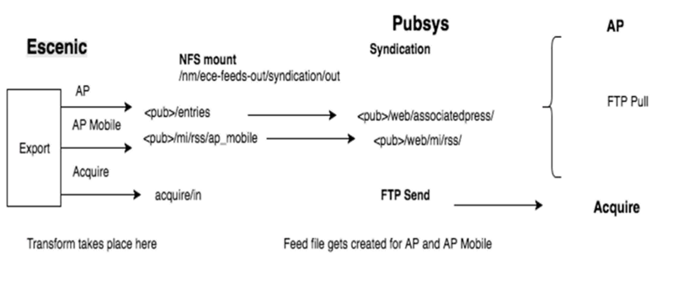
Content Sharing - Process Flow
3
4
5
1
2
The Escenic.xml file transformed to iAtom format for AP, RSS for AP Mobile, NITF format for Acquire
The transformed files copied to respective publication FTP folders and NFS mount FTS server /out directory.
PubSys syndication process executes every 5 mins.
The feed files (modified in last 2 hours for AP & stories in mi/rss/ap_mobile dir copied for AP Mobile) placed in respective directory is picked up by AP using an FTP Pull.
Uses FTP to send files from the ../acquire/in directory to a server defined by Acquire.

Slide 24
Content S haring Requirements
Associate Press:
Full text feeds in an iAtom format
No images and no associated stories, it has an image link.
Feed file is transferred to AP via an FTP pull
AP Mobile:
Truncated text with link to article in RSS 2.0 format
First 300 characters of the Lead text copied.
Include the first associated image, but no associated stories or links
Feed file is transferred to AP Mobile via an FTP pull
Acquire Media:
Full text feeds in NITF 3.2 format
No images and no associated stories
Individual files are transferred to Acquire via an FTP push

Slide 25
Escenic Export Configuration for Content Sharing
Escenic export service is used for content sharing; the export configuration can be viewed in escenic-admin.
/nm/local/etc/escenic/engine/common/com/escenic/syndication/xml path contains,
ExportManager.properties that defines the configuration to be used for AP, AP Mobile and Acquire
ApExportConfiguration.properties, ApMobileExportConfiguration.properties, and AcquireExportConfiguration.properties defines the writer, transform, and filters properties to be used and which publications to syndicate to using the Homepage section id of the publication (sectionsById property)
Directories transformers, writers, and filters contain properties files that define the Java classes to be used
Transformers: ApExportTransformer, ApMobileExportTransformer, & AcquireExportTransformer classes inside ..syndication.transformer package.
TransformProcessor: ApTransformProcesor, ApMobileTransformProcessor & AcquireTransformProcessor classes inside ..syndication.transformer package used for creating the XML documents with Tags (not with XSLT).
Writers: ApFileWriter, ApMobileFileWriter, & AcquireFileWriter classes inside ..syndication.writers package.
Filters: ApOutputFilter, ApMobileOutputFilter & AcquireOutputFilter classes inside ..syndication.filters package.

Slide 26
State Change Listener for Embargoed Stories
When a local story has an activate date/time that is later than the current time, StateChangeSyndicationListener listener checks for state change events and when the activate date/time is reached and the story becomes Published & the story is shared.
The listener is defined in /nm/local/etc/escenic/engine/common/Initial.properties
/nm/local/etc/escenic/engine/common/com/mcclatchyinteractive/escenic/ listeners Contains file StateChangeSyndicationListener.properties. That references $class=com. mcclatchyinteractive.escenic.listeners.StateChangeSyndicationListener

Slide 27
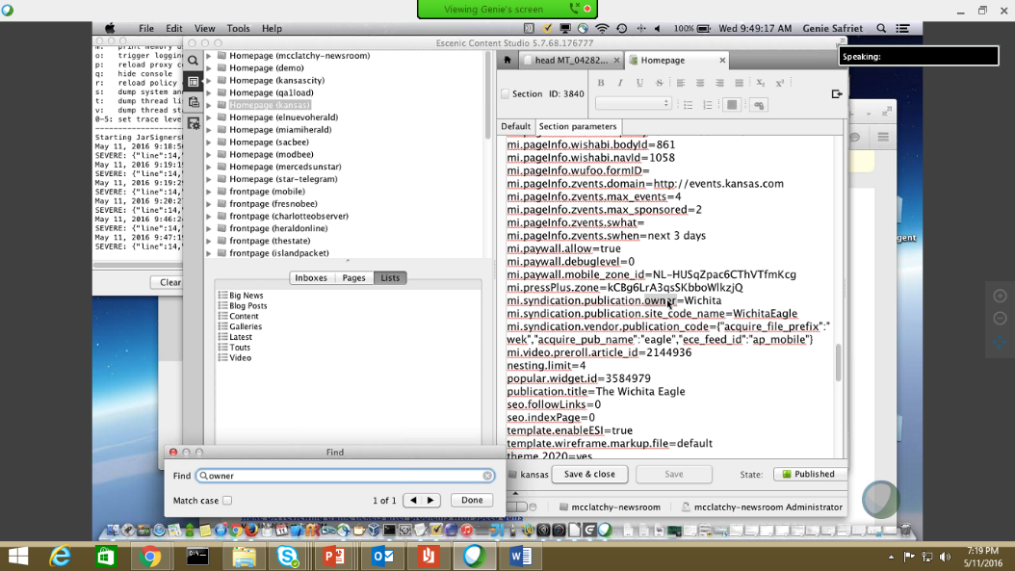
Escenic Export Code
Filter code ensures that only the correct content types (story, blog post) are syndicated
It calls the appropriate transform class to transform from Escenic xml to iAtom/ RSS/ NITF and puts the story as an xml file in the appropriate directory.
Section parameters are used to help with the export process and to define some fields in the exported files

Slide 28
PubSys Syndication – FTP Pull
The PubSys syndication process service runs every 5 minutes.
For AP all files in the entries directory modified within the last two hours are placed in the feed file.
The feed file is placed in /nm/ece-feeds-out/syndication/<publication>/web /associatedpress and is picked up by AP using an FTP Pull.
The clean-up phase only runs if new entries are written in the same processor run. The entries directory is cleaned up by removing files that have not been modified in the last two hours.
For AP Mobile whether or not new stories exist in the mi/rss/ap_mobile directory, the feed file is updated.
The feed file is placed in /nm/ece-feeds-out/syndication/<publication>/web/mi/rss and is picked up by AP using an FTP pull.
The clean-up will remove files from the mi/rss/ap_mobile directory that have not been modified in the last twenty-four hours.

Slide 29
PubSys Syndication - FTP Send
The PubSys syndication process service runs every 5 minutes.
Used for Acquire.
Uses FTP to send files from the /nm/ece-feeds-out/syndication/acquire/in directory to a server defined by Acquire.
If the FTP is successful, the files are placed in /nm/ece-feedsout/syndication/ acquire/archive.
If there is a failure, the files are placed in /nm/ece-feedsout/syndication/acquire /error.

Slide 30
Escenic – NewsGate Integration Bridge
Notes:
The below and following notes on the template slides are to guide you only. In your final presentation, you may delete these notes and add relevant notes if any.
Title slide:
Title – should not exceed beyond 3 lines, font size 30-34, Arial Headings
(Font size for the title of the PPT can vary between 30-34, Arial Headings, Bold depending on the amount of text, however should not be smaller than 30 font size)
Name should not exceed beyond 1 line, Designation; font size to remain at 18, Arial Headings
Please keep the title slide simple, just the logo, title and name and designation to appear. No other graphic elements or any design, photograph, image can be added to this slide, alignment to remain the same

Slide 31
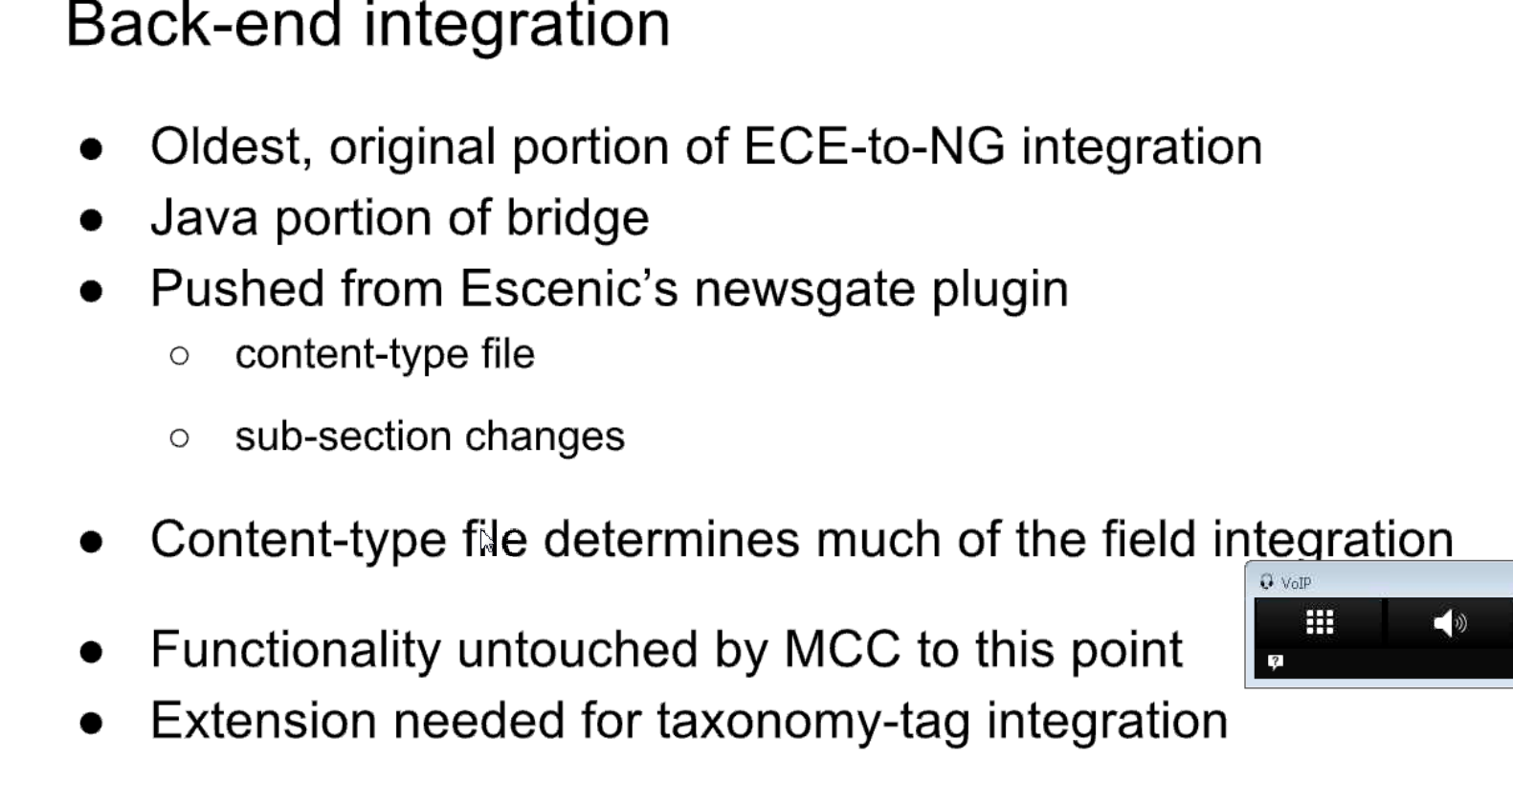
BACK-END INTEGRATION
NewsGate backend integration is the handling of updates to the content-type file and sections / sub-section changes.
This is different from NewsGate return integration, which is handling the exchange of data between NewsGate and Escenic using online packages
Notes:
Content Slide: This is usually the most frequently used slide in every presentation.
Use this slide for Text heavy slides. Text can only be used in bullet points
Title Heading – font size 30, Arial Heading
Slide Content – Should not reduce beyond Arial body font 16
If you need to use sub bullets please use the indent buttons located next to the bullets buttons in the tool bar and this will automatically provide you with the second, third, fourth & fifth level bullet styles and font sizes
Please note you can also press the tab key to create the different levels of bulleted content

Slide 32
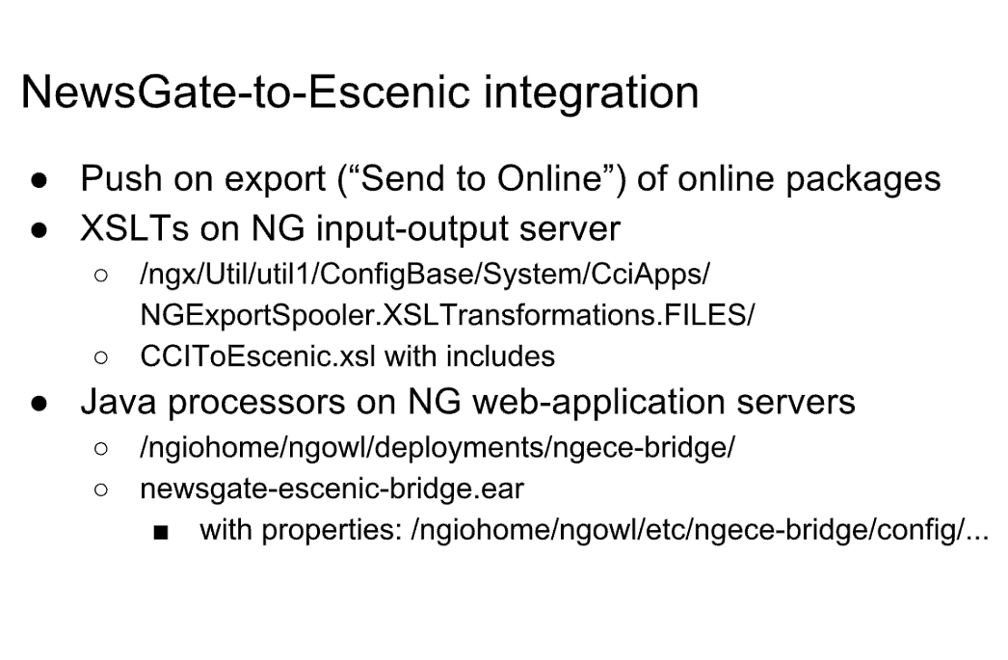
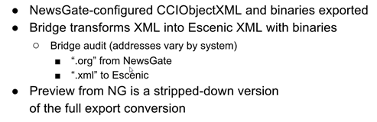
NEWSGATE TO ESCENIC INTEGRATION
Notes:
Content Slide: This is usually the most frequently used slide in every presentation.
Use this slide for Text heavy slides. Text can only be used in bullet points
Title Heading – font size 30, Arial Heading
Slide Content – Should not reduce beyond Arial body font 16
If you need to use sub bullets please use the indent buttons located next to the bullets buttons in the tool bar and this will automatically provide you with the second, third, fourth & fifth level bullet styles and font sizes
Please note you can also press the tab key to create the different levels of bulleted content

Slide 33
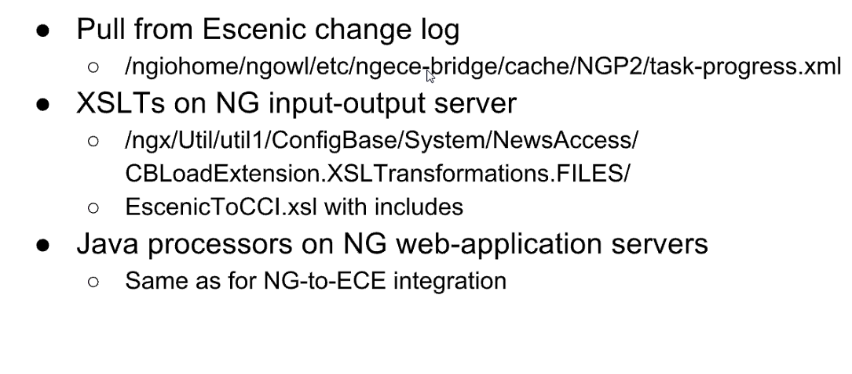
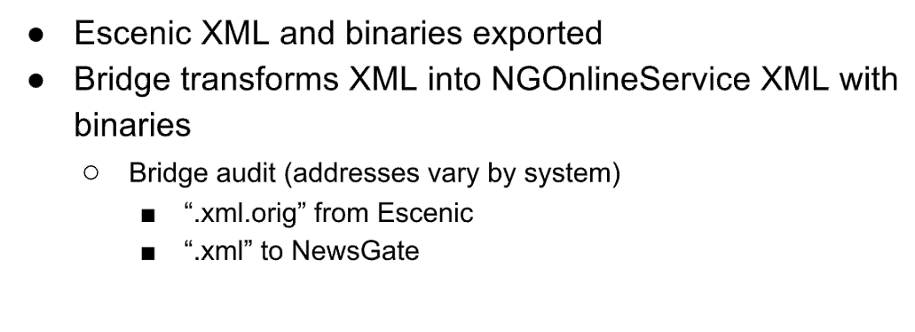
ESCENIC TO NEWSGATE INTEGRATION
Notes:
Content Slide: This is usually the most frequently used slide in every presentation.
Use this slide for Text heavy slides. Text can only be used in bullet points
Title Heading – font size 30, Arial Heading
Slide Content – Should not reduce beyond Arial body font 16
If you need to use sub bullets please use the indent buttons located next to the bullets buttons in the tool bar and this will automatically provide you with the second, third, fourth & fifth level bullet styles and font sizes
Please note you can also press the tab key to create the different levels of bulleted content

Slide 34
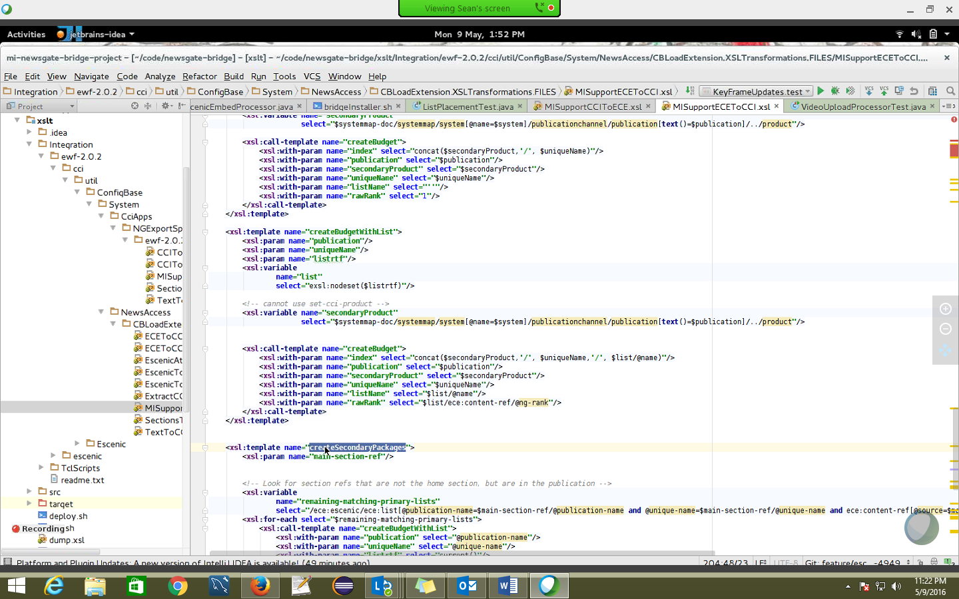
Unit Testing
If the content type file changes then the Escenic and Bridge release will happen in the same time.
If any error occurs in the Production release We are able to roll back.
Its very difficult for Escenic release.
The content type of Stories which comes from Third Party feeds is "Wire Story“. Here Reverse Integration not done.
This is the custom template for XSLT.

Slide 35
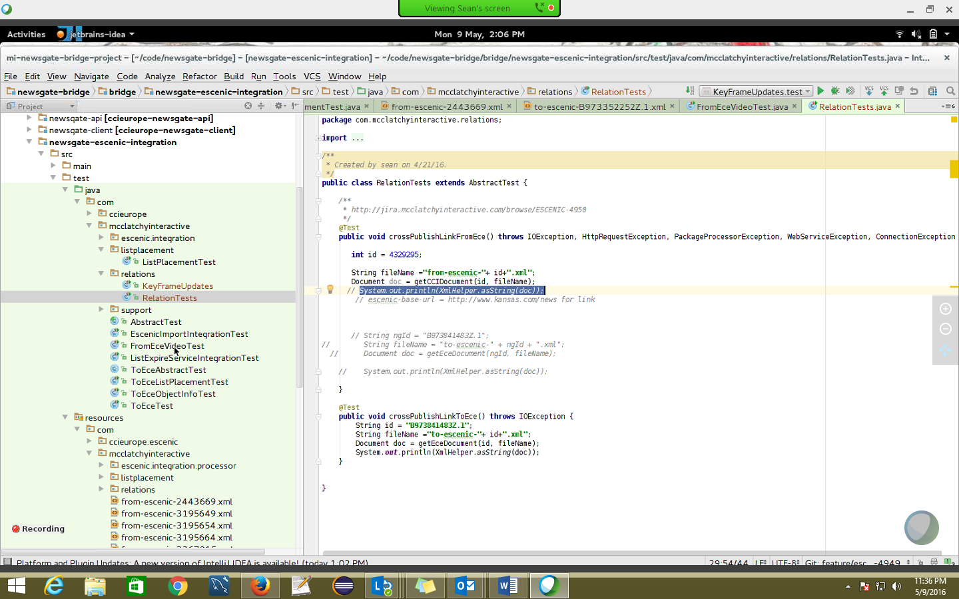
Unit Testing – Cont..
The role of the bridge is to move the content to NG to Escenic
Movie night is only to replace the widget framework (only front end changes)

Slide 36
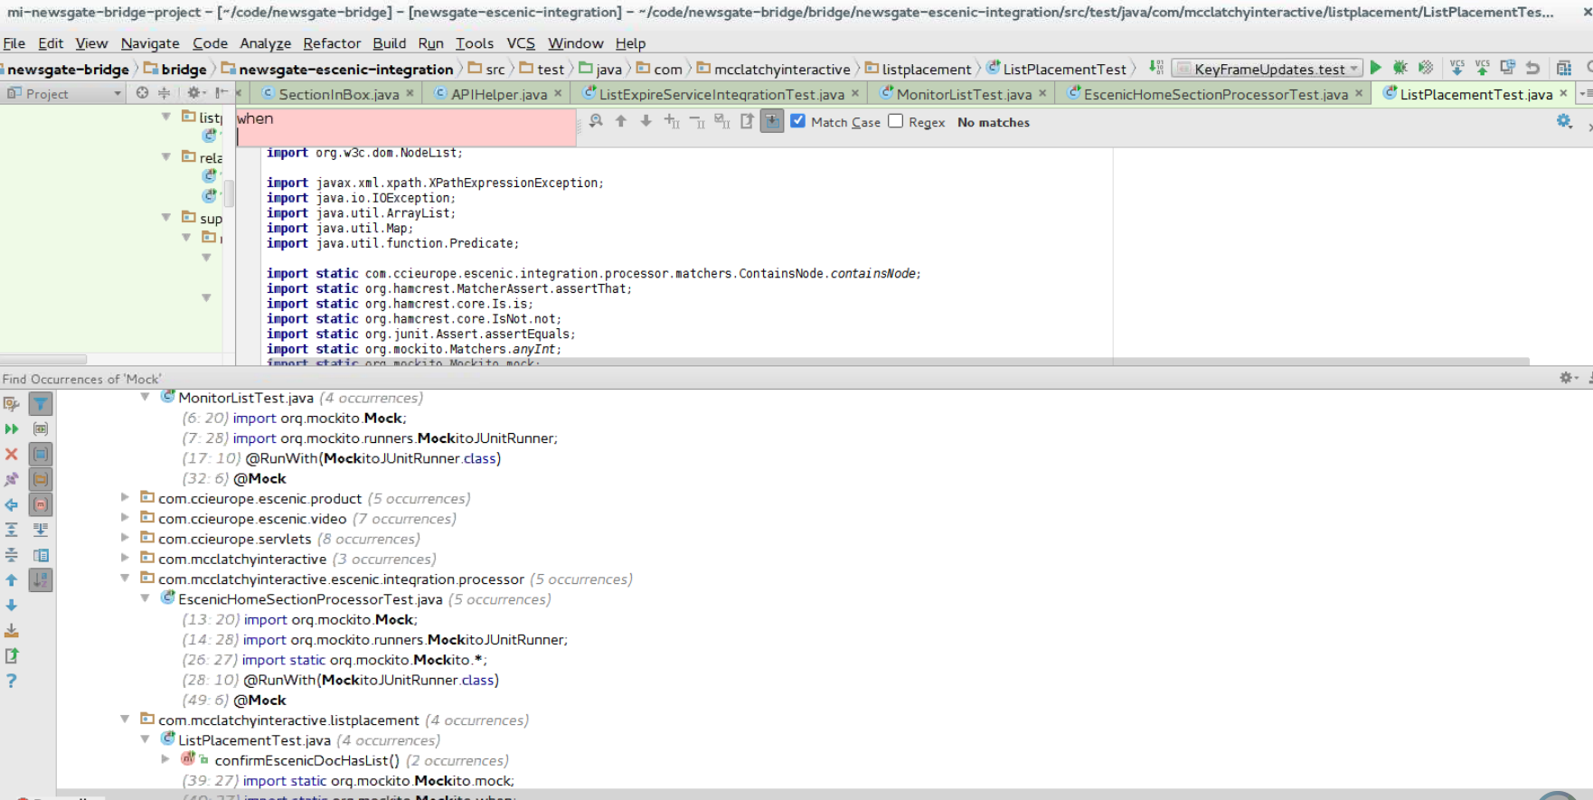
Unit Testing – Cont..
Unit Testing framework: Mockito
List integration test file. They mocked the createwebservicClientFactory method

Slide 37
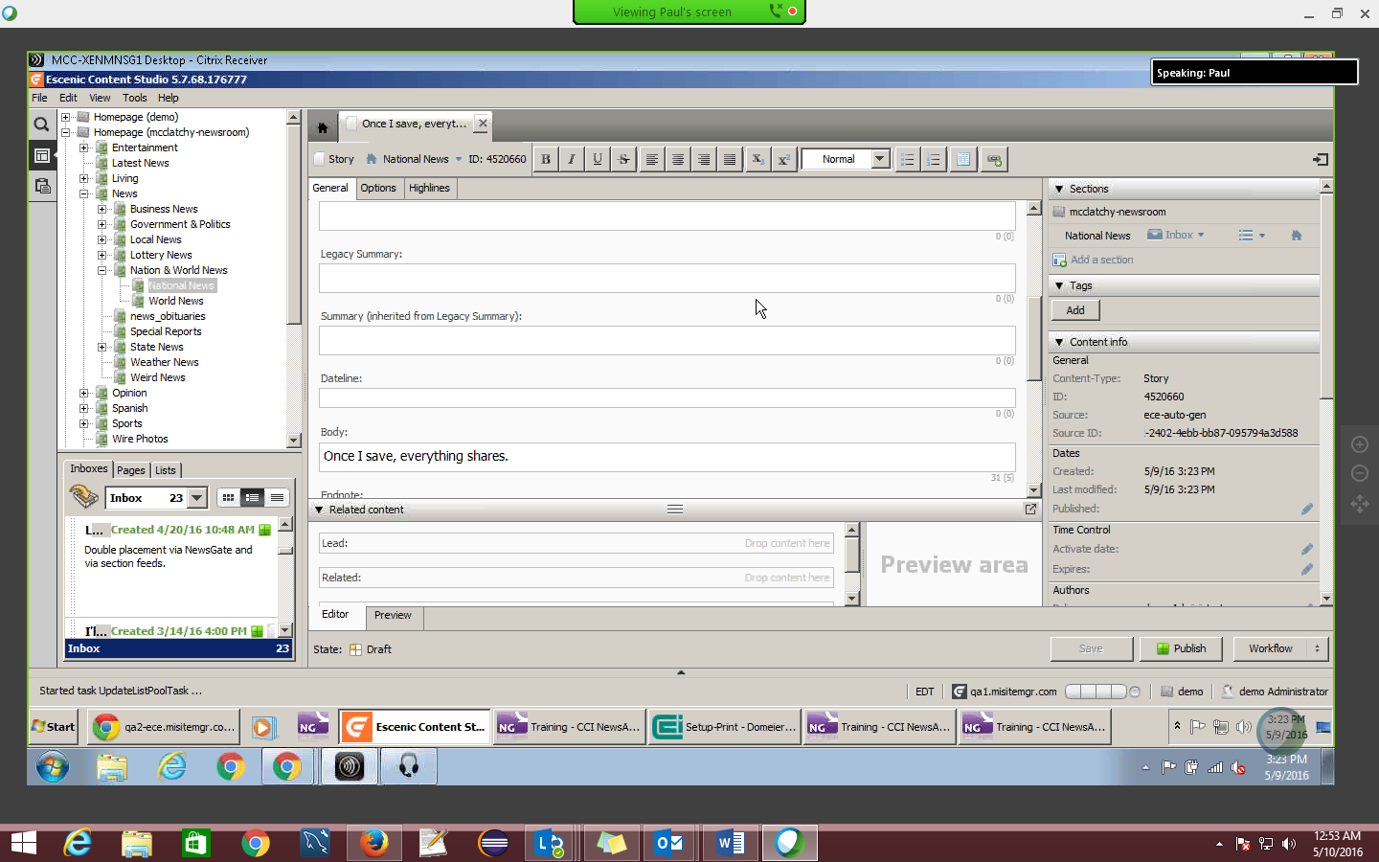
MNN & Local Data distinguished
McClatchy national news are generic news
It can be published as local news by making configuration changes in Escenic Content Studio, not by changing the bridge code in New Gate
Creating section

Slide 38
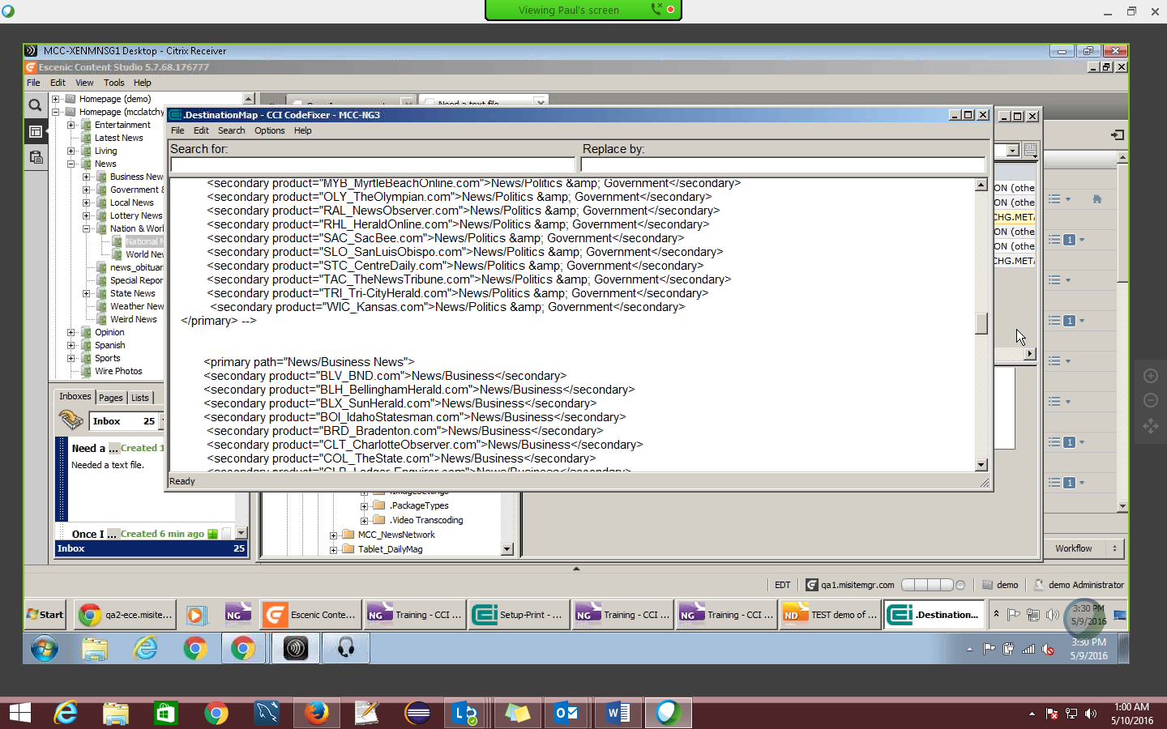
Configuration session

Slide 39
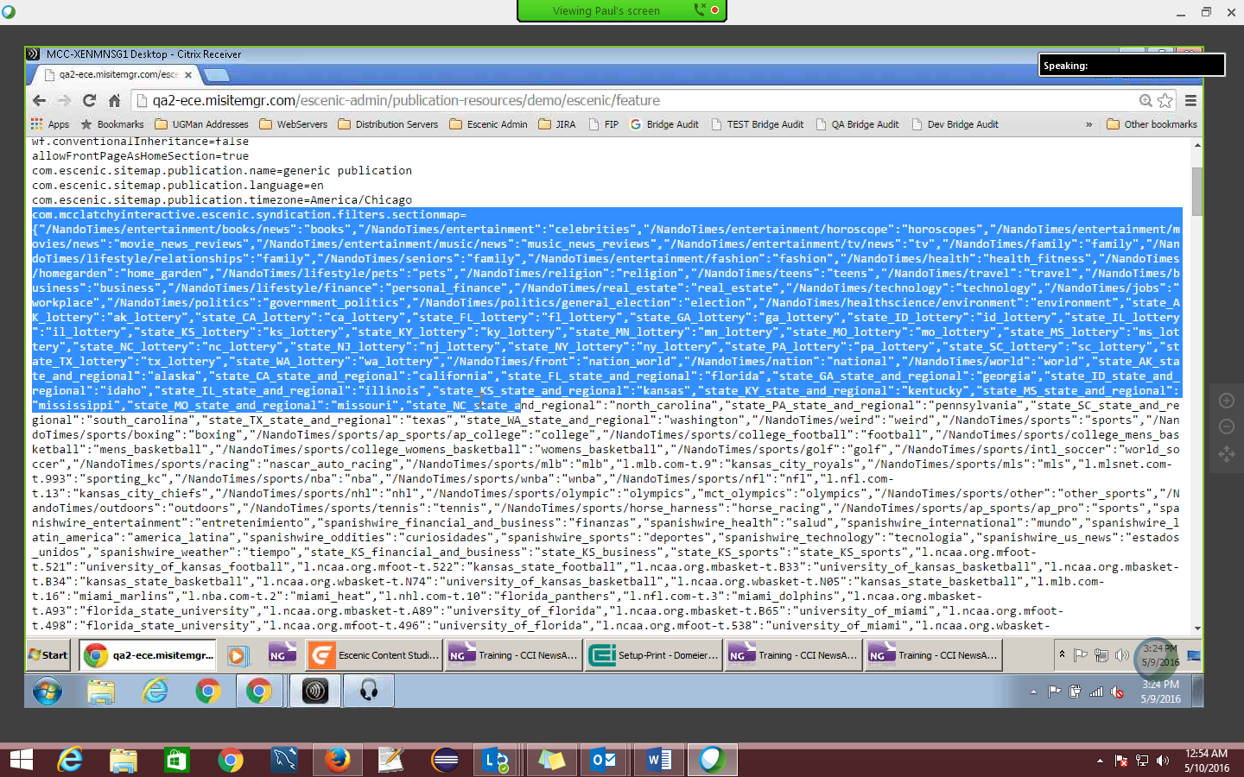
Escenic –syndication filters sitemap

Slide 40
Email Newsletters
We currently send emails via a third party: ExactTarget
We are currently moving towards another vendor: Experian
Content is generated in our CMS, pulled from there and sent via the vendor.
Most newsletter sends are completely automated and require no human intervention.
Lists
All subscriber list ­ This list contains all users in the system for the account
Newsletters/Recurring sends
Single use lists
Exclude/Suppression list

Slide 41
Email Newsletters
Manually sent emails include:
Breaking news: sent when big stories occur, manually sent from ExactTarget itself. Content is still pulled from the CMS.
Marketing sends: Custom content is manually placed in ExactTarget, list are generated per send.
Triggered emails
Email sends can be triggered based on data attributes of users, or by external scripts based on batch uploads or subscriber data.
This is done by affiliates and is generally considered to be the responsibility of affiliates.
There is no standardized way of doing this.

Slide 42
Email Newsletters
Content ­ Exact Target
Newsletters and other regularly sent content are generally set up to pull from content generated in our CMS.
Generally under MI Standardized > Newsletters > Publication
Content is scraped from a URL directly from the Escenic site
httpget "http://www.newsobserver.com/site­services/newsletters/afternoon/"%
HTML head and page bottom are inserted by ExactTarget. Basically, this is everything outside the body tags, including body tags themselves.
The footer is generated by our CMS. Placeholder variables are included in the footer which are filled in by Exact Target.
The link itself and the mechanics to unsubscribe are provided by by ExactTarget.
The unsubscribe method is completely different from marketing emails.
All ExactTarget sends and lists will be transferred to Experian.

Slide 43
Paywall
Two supported vendors
Press Plus
Syncronex

Slide 44
Paywall
In mi-core-taglibs.tld:
<tag>
<description>Paywall tag</description>
<name>paywall</name>
<tag-class>com.mcclatchyinteractive.tags.paywall.Paywall</tag-class>
<body-content>empty</body-content> <
</tag>
Head.jsp
Add taglib:
<%@ taglib prefix="mi-core" uri="/WEB-INF/tags/mi-core-taglibDescriptor.tld" %>
Add tag: <mi-core:paywall/>

Slide 45
Paywall
No paywall output if either:
● mi.paywall.allow is false
● PageLevel.VIDEO is true

Slide 46
Paywall
Press Plus JavaScript
<script>
var z='SX0aQdtL2wmlZCw6feEJwJ'; if(/Android|iPhone|iPod|iPad|webOS|BlackBerry|IEMobile|Opera Mini|Android|iPhone| iPod|iPad|webOS|BlackBerry|IEMobile|Opera Mini/i.test(navigator.userAgent) { z='pgUIpu3XN3PhUibW4DcWAJ' }; var pp={client:{ config: { 'zone':z,'mode':'universal','debug':0,'precheck':function(){return 1} } } };
</script>
<script src='http://s.ppjol.net/lightbox/pp4.js'></script>
Syncronex JavaScript
<script>
var z='free'; if(/Android|iPhone|iPod|iPad|webOS|BlackBerry|IEMobile|Opera Mini|Android|iPhone| iPod|iPad|webOS|BlackBerry|IEMobile|Opera Mini/i.test(navigator.userAgent)){ z='mobilesite' }; var categoryMeta =document.createElement("meta"); categoryMeta.setAttribute("name", "__sync_contentCategory"); categoryMeta.setAttribute("content", z); document.getElementsByTagName('head')[0].appendChild( categoryMeta ); </script>
<script type="text/javascript" src="https://www.syncaccess.net/mc/tnt/api/scripts/syncwall"> </script>

